Slide 1
Italian untranslatable words

Slide 2
Everywhere, Italians are known for their extraordinary way of making people understand what are we saying, expecially with gestures. Well, we are going to focus on some Italian words whereby no equivalent text or utterance can be found in another language when translated, because it’s a sort of lexical gap for the other countries. Are you ready? Let’s start!!

Slide 3
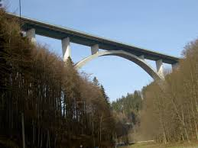
Ponte /’ponte/
No.. We are not talking about a bridge. It has also this meaning, but we use this word also in a different contest. So we make a ‘ponte’ (literally: make a bridge .. Not building it! ) when we drag on our days off.

Slide 4
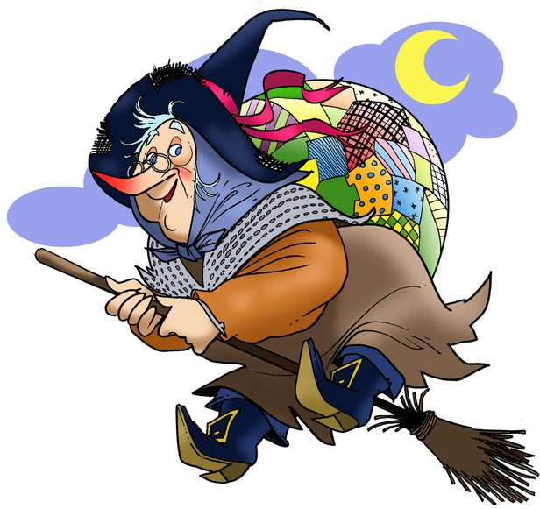
Befana /be’fa:na/
A “Befana” is an old (also ugly ) woman who looks like a good witch, that on Epiphany’s night ( 6th Januar ) gives to all the good children a gift and to the bad ones coal and ashes instead.

Slide 5
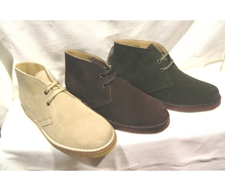
Polacchini /polak’kini/
No.. We are not talking
about Polish children.
These are high-laced boots very common and
fashionable in Italy.

Slide 6
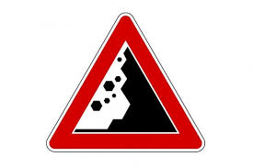
Frana /’frana/
Literally: “landslipt”, but also it can be used as a word to describe someone who is hopeless, incapable of doing everything!
Have you ever met this kind of person?
Yep.. Now you have the exact word to call him/her.

Slide 7
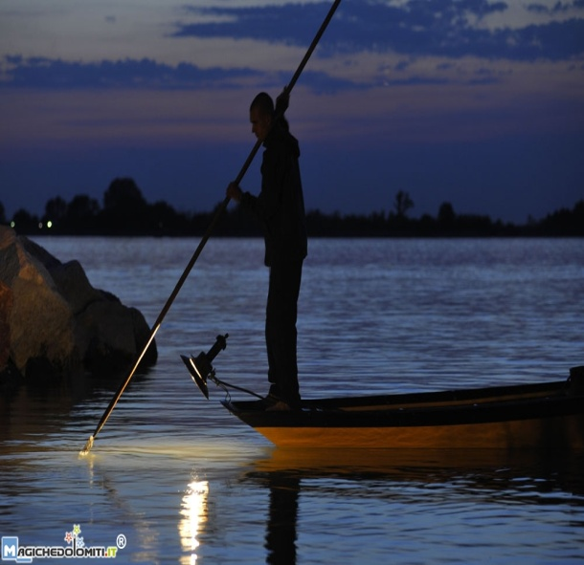
Lampara /lam’para/
It’s a particular kind of light used for fishing by lamplight in Mediterranean.

Slide 8
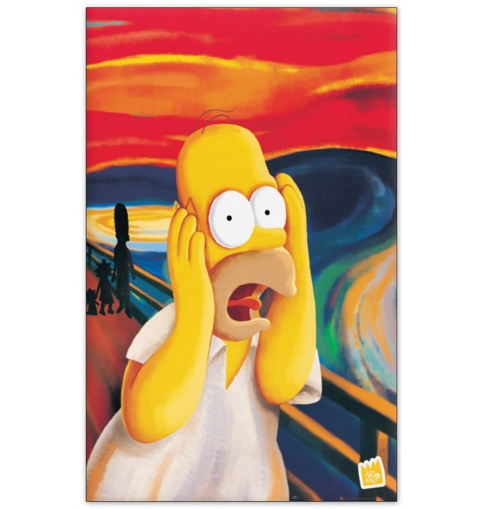
Spagnarsi /‘spaɲarsi/
This means to be afraid of something or someone.
The fact that this word comes from “ Spagna” is linked to the Spanish invasion of the past century, in fact , it sounds like “ to be frightened by Spanish”

Slide 9
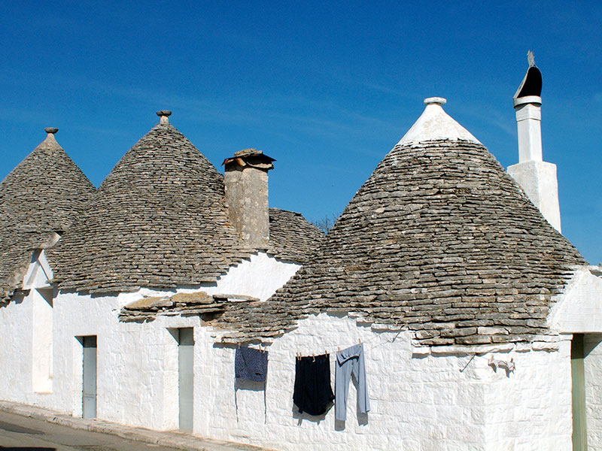
Trullo /’trullo/
Have you ever seen this ones? It’s a particular building, a cylindrical house with conical roof which is typical in a place in the south of Italy.

Slide 10
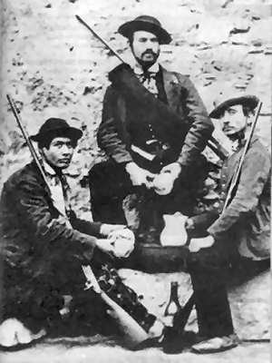
Brigante /bri’gante/
It’s a sort of bandit, but here in Italy it has a good meaning because during the unification of Italy a lot of these people try to rebel against the Lords and its tiranny.

Slide 11
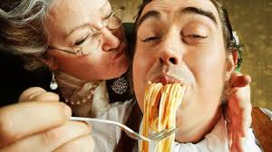
Mammismo /mam’mizmo/
Unfortunately, a very
common Italian phenomena.
This is an excessive devotion to one’s mother, and it’s particulary widespread
among men who can’t stand too far from their mothers, which are worshipped like a Goddess.
Usually, Italian girls find this kind of men very unsuitable.

Slide 12
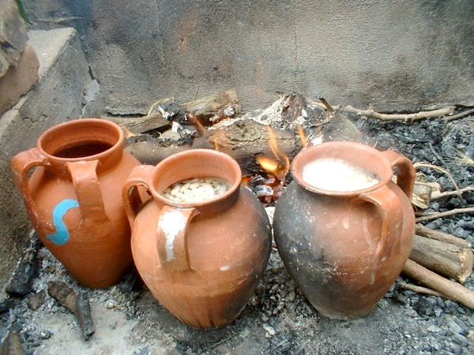
Pignatta /piɲ’ɲatta/
A particular terra-cotta anphora which is used for cooking legumes.

Slide 13
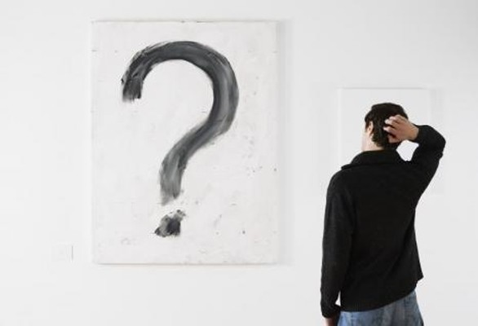
Mah! /ma:/
A word with no meaning, a saying that you can use when you don’t know what to say or do, when you are in doubt, or upset, similar to “ who knows?” .

Slide 14
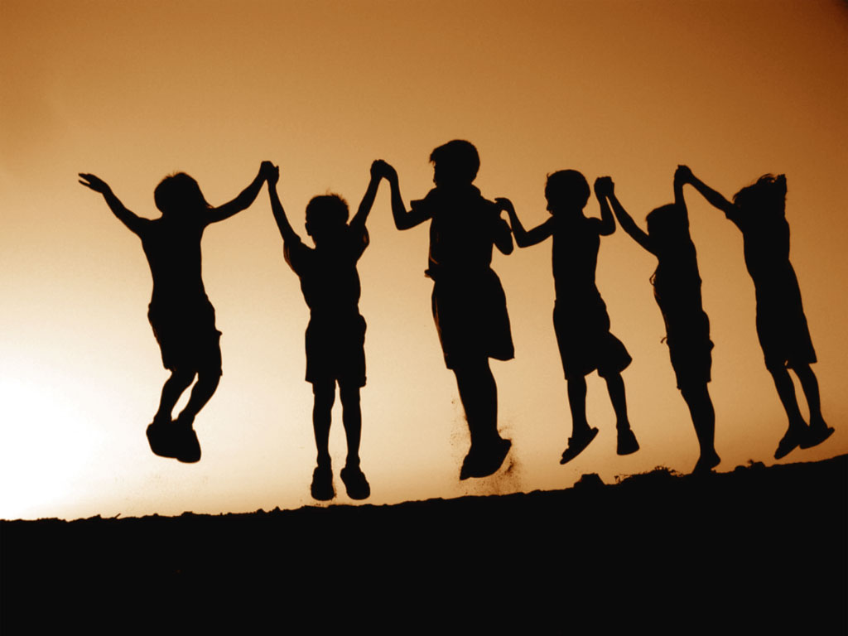
Ti voglio bene /ti voʎio ‘bene/
This is a common expression that you can use to say to your friend, your parents or someone else that you …”love them? “ Well, it’s not that way. When we love someone, for example a husband, we say “ ti amo”, that it’s linked to love. If we say “ ti voglio bene! “ to a friend,it’s affection.

Slide 15
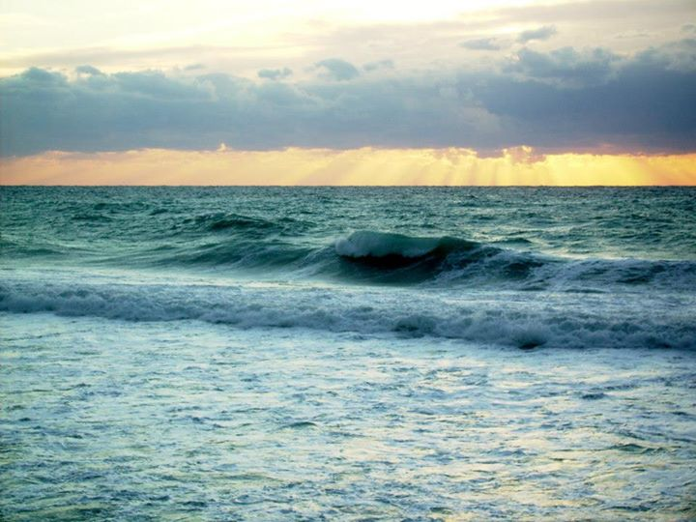
Frago /’frago/
It’s the poetic noise that the sea-waves make when they smash into the shoreline.

